Slide 1
Agenda – Day 1
Review Objectives for Training and Introductions
GitHub Files…did you get them?
Review Mirth Connect – What is it?
Install Mirth Connect Locally
Run and Connect to Mirth Connect Locally
Overview of the service and manager
Overview of the UI
Create our first channel – Hello World Mirth
Questions
Sum up of Day 1

Slide 2
Objectives
Provide an overview of the mirth connect software
Hands on approach to installing mirth
Touring mirth connect
Services
Server Manager
Administrator
Create our first channel together

Slide 3
GitHub Files
https://github.com/jstevenson81/mirth-training
Contains all the files we’ll use today
Were you able to get them?

Slide 4
What is Mirth Connect
Mirth Connect Is…
An interface engine
Mirth is an open source cross-platform HL7 interface engine that enables bi-directional sending of HL7 messages between systems and applications over multiple transports.
Based in healthcare
Designed to receive and process messages from all types of sources
Designed to process the received messages and send to all types of destinations
Similar to an ETL system
Manager of connections, sources and destinations

Slide 5
What is Mirth Connect
Mirth Connect is not
A programing language
A system to develop and deploy custom applications
An integrated development environment (IDE)
However, administrator is similar to an IDE
An ETL system (Extract Transform Load)
Costly
Complicated to maintain
A set it and forget it system. It needs love too.

Slide 6
Mirth Connect Parts
Engine
The engine is the service that processes messages.
Creates logs and message history
Manages the system database
Allows for replay and sending of messages
Administrator
Management of existing interfaces
Development of existing interfaces
Server Manager
GUI to allow you to modify/manage configuration

Slide 7
Pre-Requisites (Development)
JAVA
The latest version of the JRE is required
Mirth Connect (latest version)
Windows, Mac or Linux

Slide 8
Pre-Requisites (PRODUCTION)
JAVA
The latest version of the JRE is required
Mirth Connect (latest version)
Windows Server or Linux Server (Ubuntu recommended)
SQL Server Express, MySQL or Postgres SQL
This is to allow mirth to store messages and configuration in a database.
Storing in a database allows for backup of the database and ease of restoring to a point in time

Slide 9
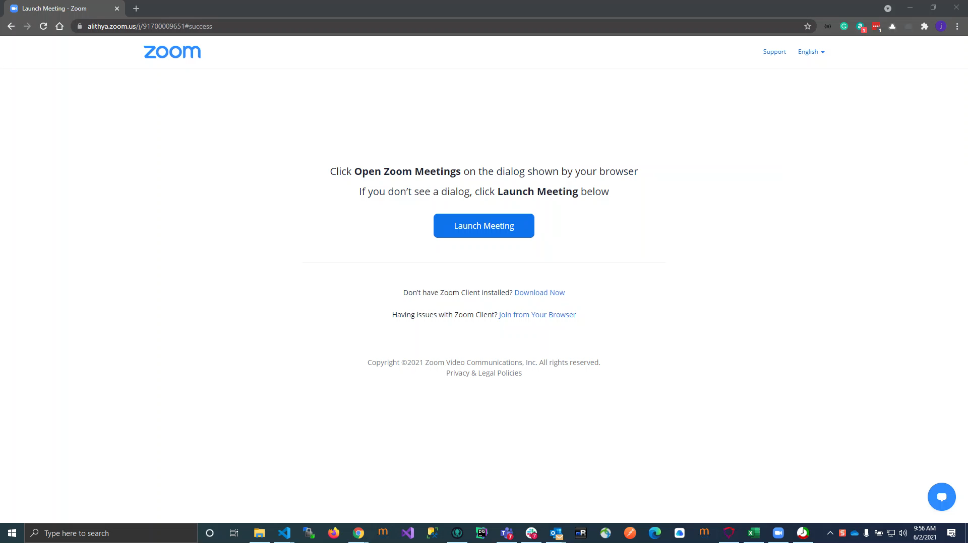
Installation
Let’s watch a video Jonathan created for this introduction to installation
Let’s do it together

Slide 10
Overview of Engine
Let’s take a look at what we just installed
Let’s take a look at the server manager interface
Modify a few settings to support development

Slide 11
Overview of Administrator
Open administrator
Create connection to our local engine
Change admin password
Tour the interface

Slide 12
Creating our First Channel
Let’s create our first channel – Hello World Mirth
New Channel
Tour the options for the channel
Tour the options for source
Tour the options for transformers
Tour the options for destinations (yes there can be many for one source)
Code our first channel
Run the channel and review the output

Slide 13
First Channel
Requirements
We must read a delimited text file. The delimiter is a pipe (|)
We must convert that delimited text to JSON
We must send the JSON to the same channel and review the output in administrator

Slide 14
First Channel (Cont)
Delimited text
First Name, Last Name, gender, birth date (MM-DD-YYYY), address, city, state, zip, phone
Output
{[
FullName: concatenated first and last name,
Gender: M, F or O,
BirthDate: yyyy-MM-dd,
Address: string,
City: string,
State: string,
Zip: number
Phone: string
]}

Slide 15
Sample File
Preview the file in notepad++
Jonathan to send file via email
Review any questions related to the file.

Slide 16
Channel Build
Build the channel together
Who’s going to be the guinea pig?

Slide 17
Questions?

Slide 18
Sum up and Review for Tomorrow
Day one summary
Day 2 preview
Closing

